Slide 1


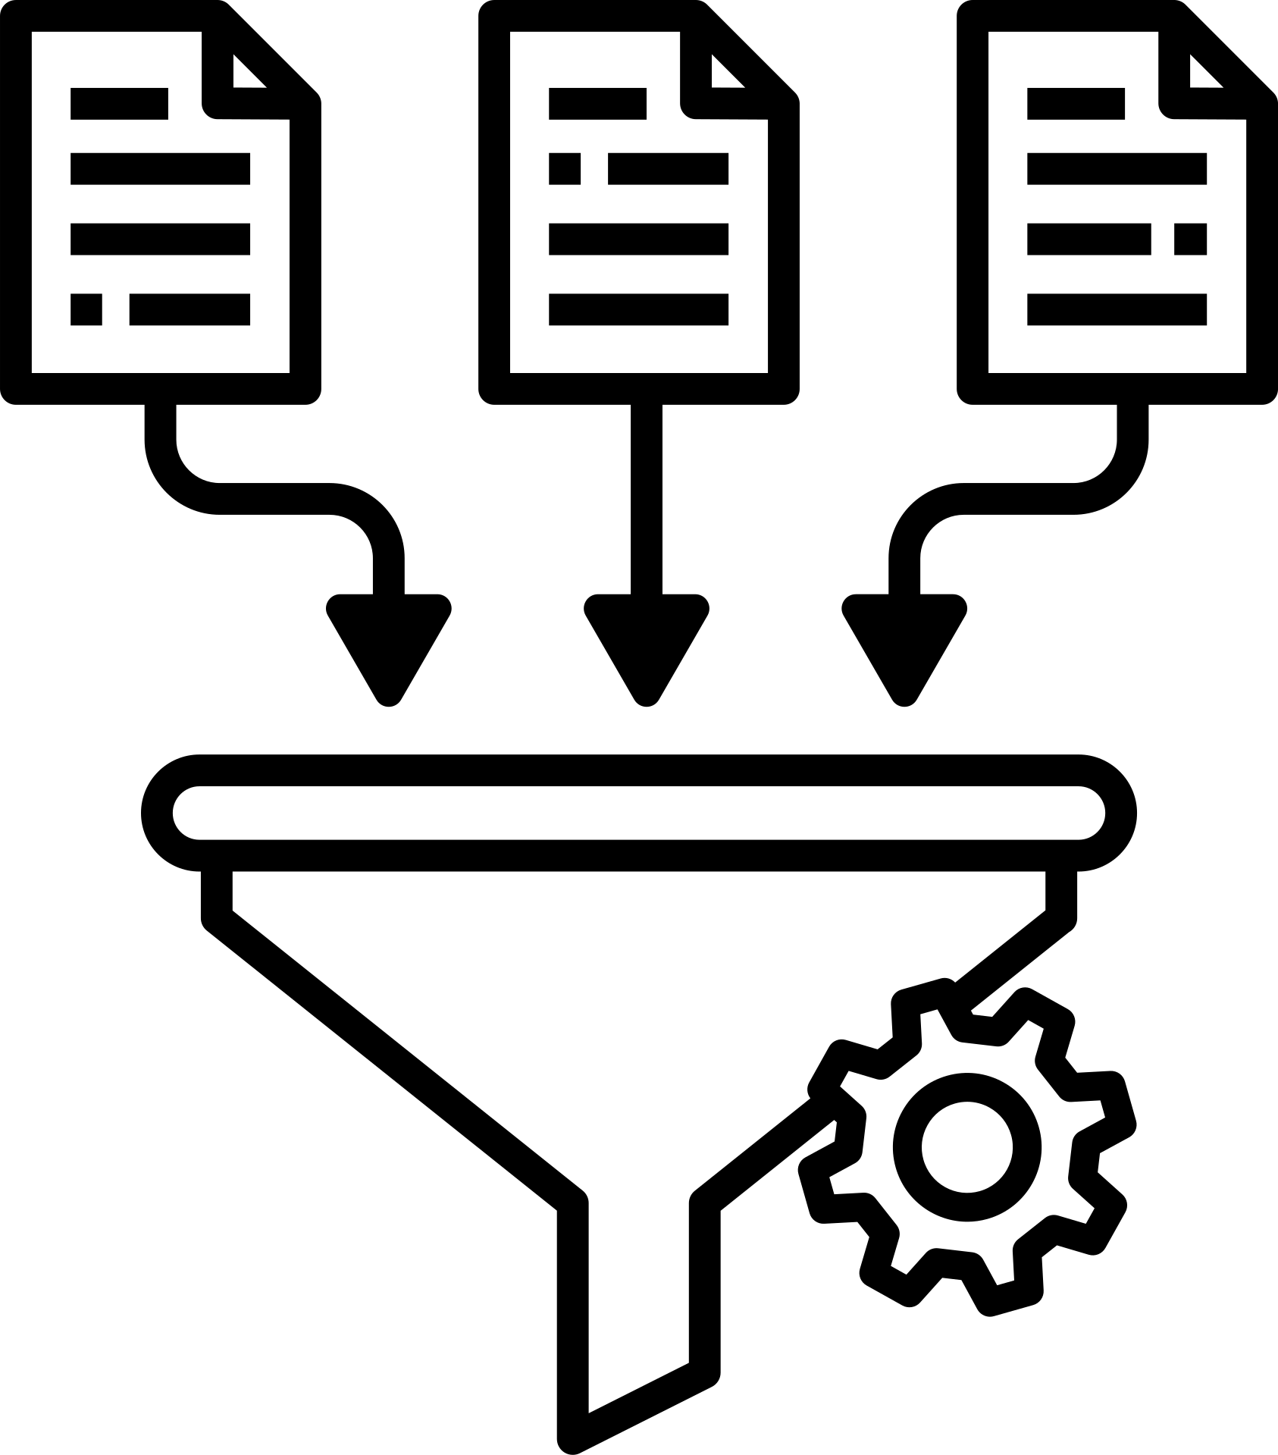

End-to-End SQL Analysis of Olist E-Commerce Dataset
Presented by: Sai krishna Panuganti

Slide 2




Project Objective
To analyze a comprehensive e-commerce dataset (~100,000 orders) to identify key trends in business growth, customer geography, and logistics performance, ultimately providing actionable recommendations to drive business strategy.

Slide 3


My Toolkit
MySQL
Canva

Slide 4
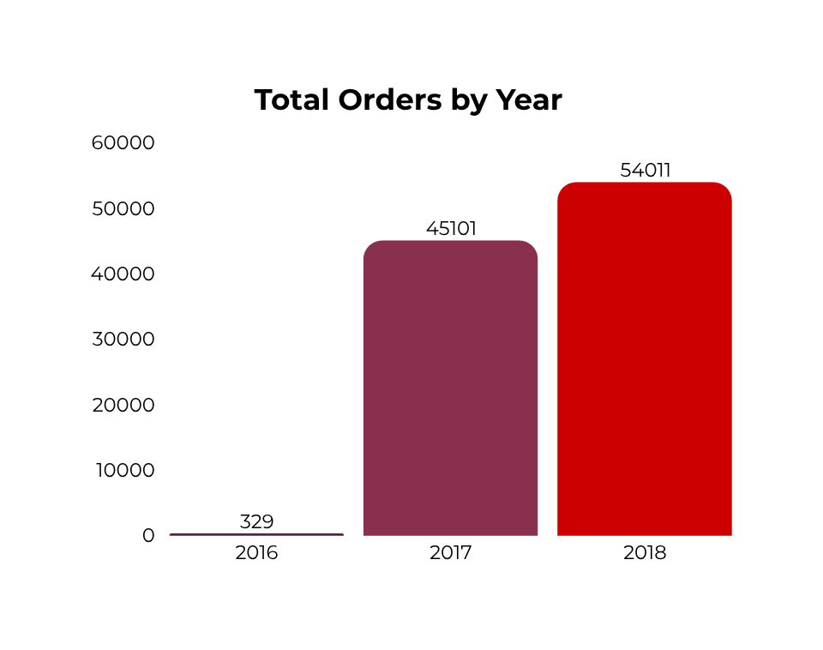
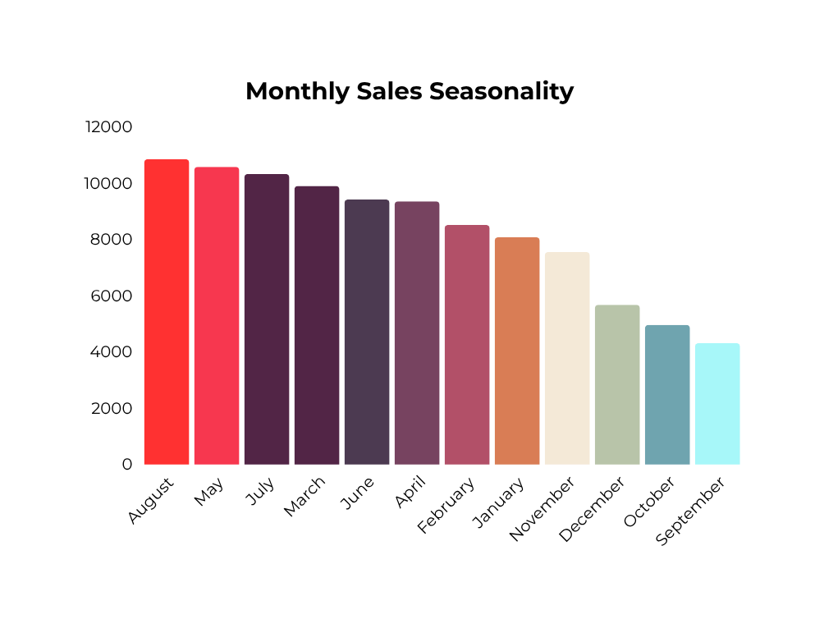
INSIGHT 1: Explosive Growth & Distinct Seasonality
The business shows a massive 136% year-over-year sales increase, with a clear sales peak in August that differs from typical holiday rushes.

Slide 5
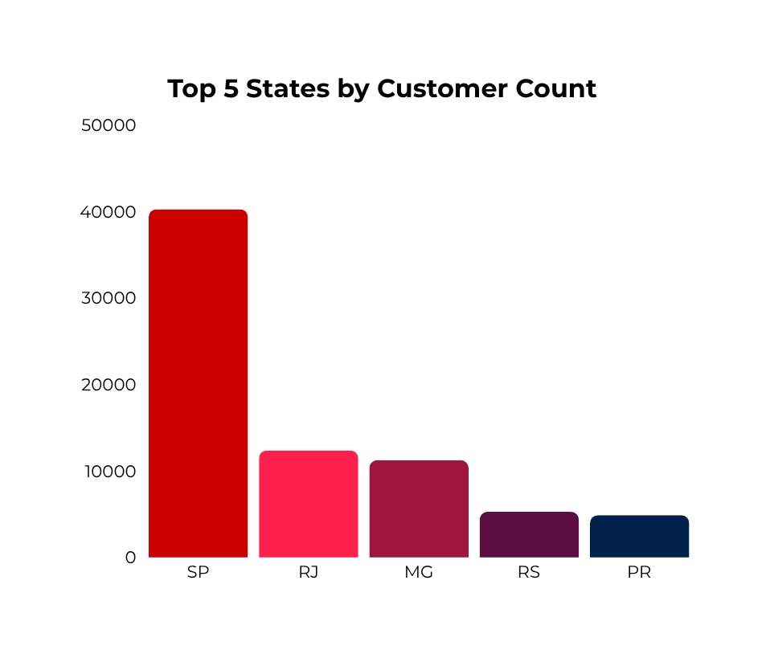
INSIGHT 2: São Paulo is the Undisputed Geographic Engine
The business is dominated by the Southeast. São Paulo (SP) alone has more than 3x the customers of the next largest state and also benefits from the fastest and cheapest shipping.
Logistics: A Tale of Two States
STATE | Avg. Shipping Cost | Avg. Delivery Time
SP | $17.65 | 8.3 days
RR | $60.10 | 29.3 days

Slide 6
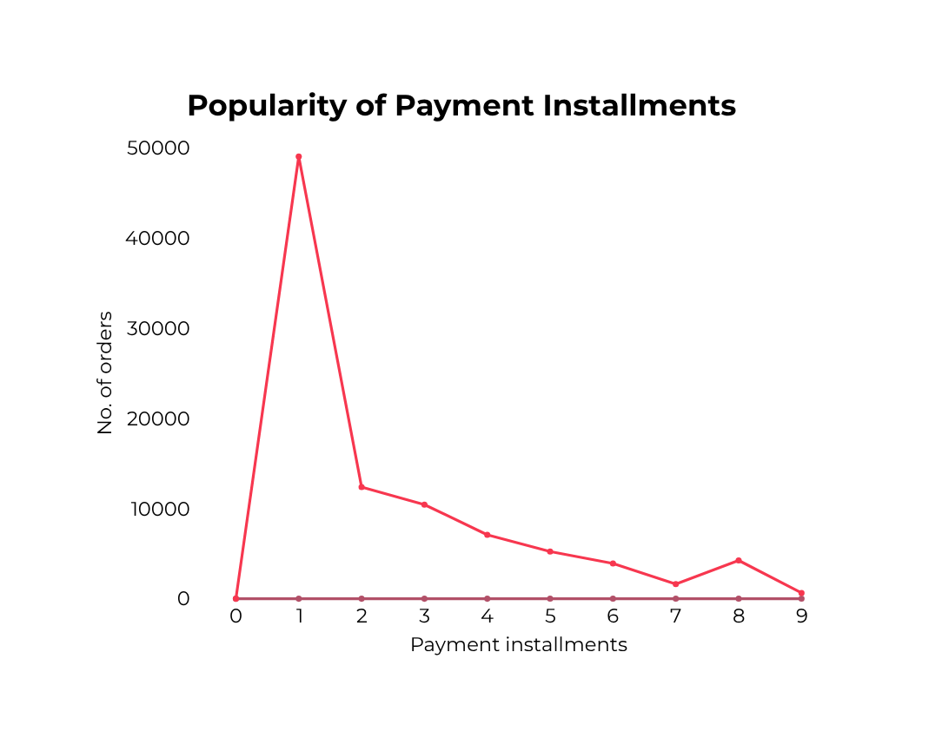
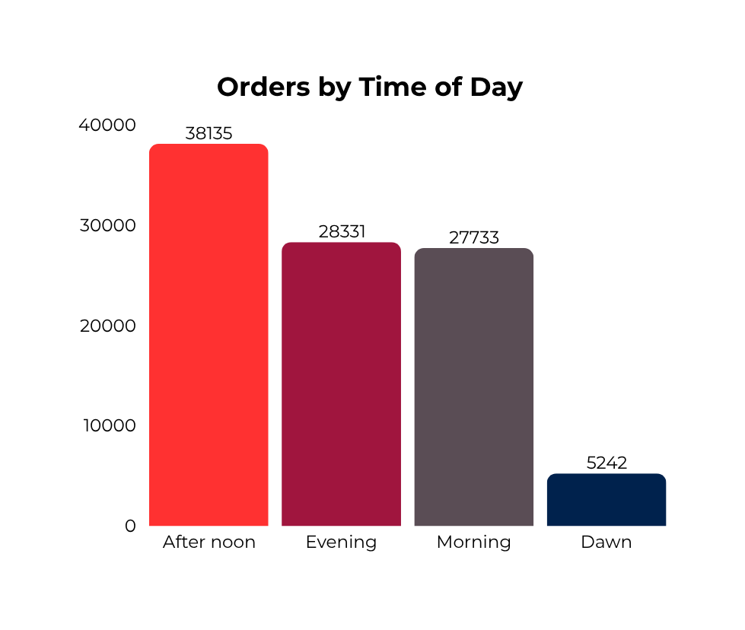

INSIGHT 3: The Afternoon Rush & The Power of Installment Plans
Shopping activity peaks in the afternoon. While single payments are most common, the option to pay in installments is a critical feature for a large number of customers.
“Single payments are nearly 5x more common than paying in two installments”

Slide 7
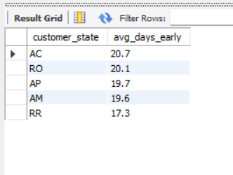

INSIGHT 4: Smart Logistics - Managing Customer Expectations
While objective delivery times to remote states can be long, the company provides generous estimates. This results in packages arriving, on average, more than 14 days ahead of the promised date, leading to happier customers.

Slide 8



Actionable Recommendations
Counter the Seasonal Dip: Launch targeted marketing campaigns and promotions in September and October to address the slowest sales months of the year.
Unlock New Markets: Investigate new logistics partnerships to reduce the high shipping costs and long delivery times to the North/Northeast regions.
Maximize Peak Traffic: Focus flash sales and new product launches during the peak afternoon shopping window (1 PM - 4 PM) to maximize conversion.

Slide 9

Thank you!
I'm passionate about using data to tell stories and drive business decisions. Let's Connect!
Let’s connect!

